Slide 1
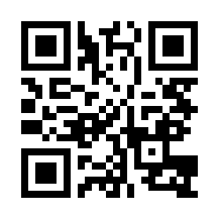


Software Development Quick-Start Quiz
https://bit.ly/334zqQW

